Slide 1



Cancer care insight
Empowering women's’ health

Slide 2
Team Members
01
Aya Ahmed
02
Esraa Khamis
03
Sohaila Elbadry
04
Mariam Samouil
05
Yasmin Gamal
06
Youstina Wiliam
Supervised By
Dr/ Mary Monir

Slide 3
Agenda
1-System overview
2-System objectives
4-System diagram
4-Used technologies
5-Dataset
6-Project limitations
7-Project scheduling
8-UI/UX Designs
9-Refrencess

Slide 4
Why Breast Cancer ?
Breast cancer is the second most common cancer, and the fifth cause of cancer deaths in the world. It is the most common in women worldwide. In Egypt, it is the most common cause of cancer mortality in women. Egypt has a value of 57/100 on the index of effective coverage in breast cancer treatment.

Slide 5
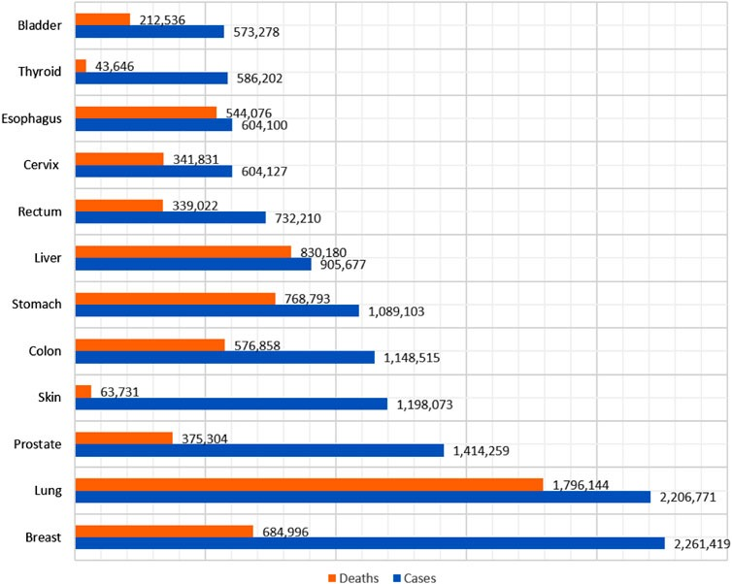
Breast cancer has exceeded lung cancer as the most commonly diagnosed cancer and the fifth cause of cancer deaths in the world, with an estimated 2.3 million cases and 685,000 deaths in 2020.

Slide 6
Problem description
Breast cancer is highly prevalent in Egypt, with approximately 25,000 cases diagnosed annually. The current screening process involves radiological examinations, which are time-consuming and contribute to overcrowded hospitals. Informing patients of results and conducting further tests for treatment determination add to the strain on medical facilities. Frequent doctor visits exacerbate congestion, hindering efficient diagnosis and treatment of breast cancer patients.

Slide 7
Solution Proposal
Developing an automated breast cancer detection and classification system from mammography images. Implementing streamlined communication channels for delivering results to patients. Introducing telemedicine options to reduce the need for frequent doctor visits. Utilizing data analytics to optimize appointment scheduling and resource allocation. Benefits:
Enhanced efficiency and accessibility of breast cancer diagnosis and treatment. Reduced strain on healthcare facilities, leading to improved patient care. Increased patient satisfaction through streamlined processes and reduced waiting times.

Slide 8
System Overview
Our system is a specialized web-based platform designed to support medical professionals in the diagnosis and treatment of breast cancer. Recognizing the limitations of tumor classification methods, our system integrates advanced molecular techniques to refine and improve diagnostic accuracy.

Slide 9
2. System Objectives
Improve diagnostic accuracy through the integration of advanced molecular techniques.
Enhance tumour classification using advanced algorithms , machine learning and deep learning.
Streamline workflow for medical professionals involved in breast cancer diagnosis and treatment.

Slide 10
2. System Objectives
Integrate diverse data sources for a comprehensive view of each patient's condition.
Promote collaboration and knowledge sharing among medical professionals.
Support ongoing research and development in breast cancer diagnosis and treatment.

Slide 11
Survey :
Reference | Title | Dataset | Accuracy | Approach | Architecture Method
1 | “Breast Abnormalities' Classification Using Convolutional Neural Network using CBIS-DDSM dataset.“ | CBIS-DDSM | 88% | Proposes a classification method using a Convolutional Neural Network (CNN) to classify breast abnormalities. | CNN
2 | “Breast cancer detection: Shallow convolutional neural network against deep convolutional neural networks..." | CBIS-DDSM INbreast | 93% | Compares a shallow CNN with deep CNN-based approaches for breast cancer detection. | Shallow CNN, Deep CNN
3 | “ Integration of radiomics and machine learning for breast cancer diagnosis using CBIS-DDSM dataset." | CBIS-DDSM | 90% | Proposes an integrated approach combining radiomics and machine learning for breast cancer diagnosis. | Radiomics, Machine Learning
And our proposed system use CBIS-DDSM dataset with accuracy 96.0%

Slide 12
3. System Diagram
Feel pain during monthly test
Mammogram examination
CNN Model
Malignant
Benign

Slide 13
3. System Diagram (cont..)
Malignant
Deep learning
Malignant
Benign
Chemo therapy
Hermon therapy
Target therapy

Slide 14
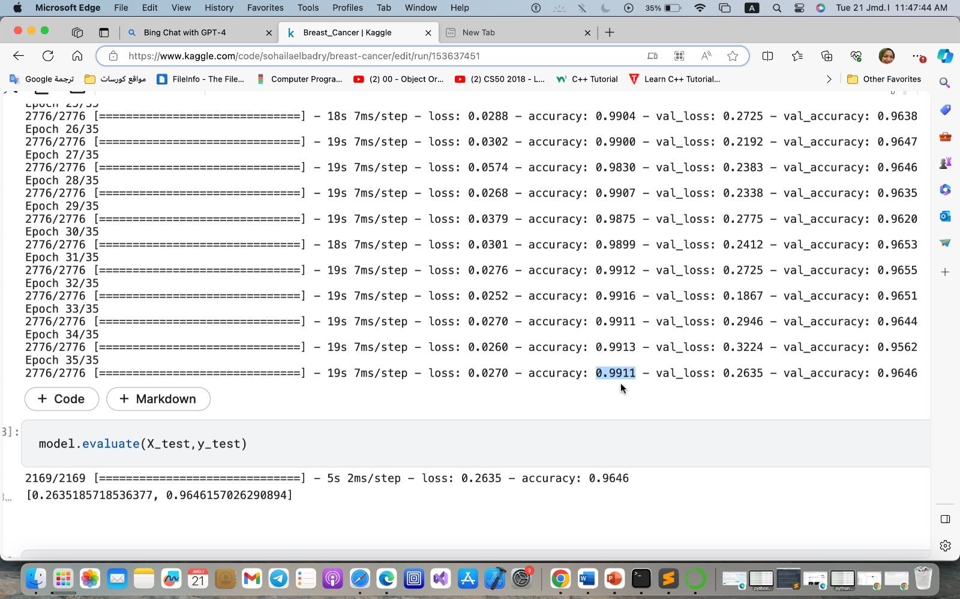
Our Frist Proposed System

Slide 15
4.Used Technologies
Deep learning
CNN (Conventional Neural Network)
RNNs (Recurrent Neural Networks )
DNA microarray (Gene Expression)
React
PHP Laravel
Flask

Slide 16
Deep Learning
Deep learning is a subfield of machine learning and artificial intelligence (AI) that focuses on training artificial neural networks with multiple layers to learn and make intelligent decisions or predictions from complex and large-scale data. Deep learning models are designed to automatically learn hierarchical representations of data by iteratively extracting and transforming features from raw input.
The term "deep" refers to the depth of the neural network, which means it has multiple hidden layers between the input and output layers. Each layer consists of interconnected nodes, called artificial neurons or units, which perform computations on the input data. The output of one layer serves as the input to the next layer, enabling the network to learn increasingly abstract and complex representations of the data.

Slide 17
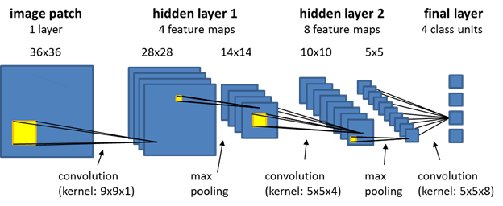
CNN
CNN stands for Convolutional Neural Network. It is a type of deep learning neural network that is particularly effective in processing and analysing visual data, such as images and videos. CNNs are inspired by the visual processing mechanism in the human brain and are designed to automatically learn and extract features from raw input data.
The key characteristic of CNNs is the use of convolutional layers, which apply filters or kernels to the input data, enabling the network to learn local and spatial hierarchies of features. These convolutional layers are followed by pooling layers, which down sample the feature maps to reduce computational complexity and extract the most relevant information.

Slide 18
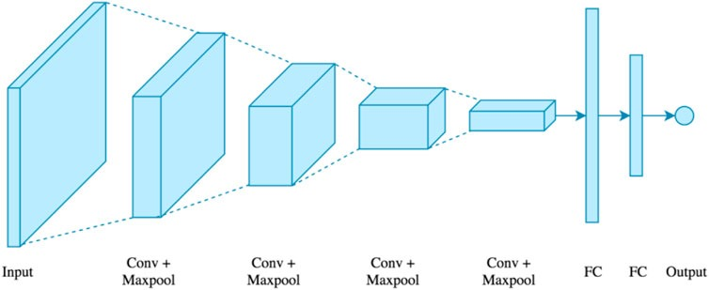
RNNs
RNNs are neural networks designed for sequential data processing. They have feedback connections that allow information to persist across time steps.
RNNs excel in capturing temporal dependencies and handling variable-length sequences.
Applications of RNNs include NLP, speech recognition, time series prediction, and image/video captioning. Ongoing research aims to address challenges and improve RNN performance.

Slide 19
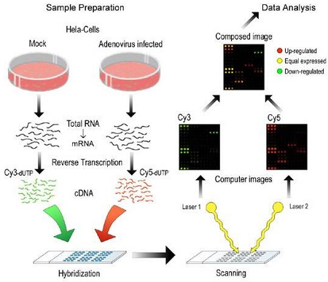
DNA Microarray
DNA microarray is a powerful technology used to measure gene expression levels. It allows simultaneous analysis of thousands of genes in a single experiment.
Gene expression data obtained from microarrays provides insights into cellular processes and diseases.
Microarrays help identify differentially expressed genes and uncover molecular signatures. They play a crucial role in genomics research, personalized medicine, and biomarker discovery.

Slide 20

React
React is a popular JavaScript library for building user interfaces (UIs) in the frontend of web applications. It was developed by Facebook and has gained widespread adoption due to its efficiency, flexibility, and component-based architecture.
React allows developers to create reusable UI components that can be composed together to build complex user interfaces. It uses a virtual DOM (Document Object Model) to efficiently update and render UI components based on changes in the application's state.

Slide 21

PHP Laravel
PHP Laravel is a widely-used open-source web application framework written in PHP. Built on the Model-View-Controller (MVC) architectural pattern, Laravel provides developers with a comprehensive set of tools and features for developing modern and scalable web applications. It offers a clean and elegant syntax, making it easy to write expressive and readable code. Laravel includes features like routing, database management with Eloquent ORM, a powerful templating engine called Blade, authentication and authorization mechanisms, caching, testing support, and more. With its robust ecosystem and active community, Laravel has become a popular choice for PHP developers looking to build efficient, maintainable, and feature-rich web applications.

Slide 22

Flask
Flask is well-suited for integrating AI applications or models due to its flexibility and simplicity. It is a lightweight and flexible web framework for Python. It is designed to be easy to use and to give developers the freedom to choose the tools and libraries they prefer. Flask is classified as a micro-framework, meaning that it provides the core components needed for web development, but leaves many decisions, such as database choice and authentication methods, to the developer.

Slide 23
5
Dataset

Slide 24
Dataset
The Digital Database for Screening Mammography (DDSM) is a collection of 2,620 mammography studies, including normal, benign, and malignant cases. The Curated Breast Imaging Subset of DDSM (CBIS-DDSM) is an updated, standardized version with images in DICOM format and additional data like ROI segmentation. It’s used for research in computer-aided diagnosis and detection systems in mammography.

Slide 25
6. Project Limitations
Result
Limitation
Data frame
Limitation
Resource
Limitation
Accurate results and close to the tumor diagnose model.
Due to the diverse origins of the dataset encompassing various geographical locations, potential disparities in data quality and consistency may arise, impacting the accuracy and generalizability of findings within the breast cancer website.
• For Developer: A computer with high “GPU” for model training.
• For User: a phone/pc with internet connection .
Find a good data set.

Slide 26
7. Project scheduling

Slide 27
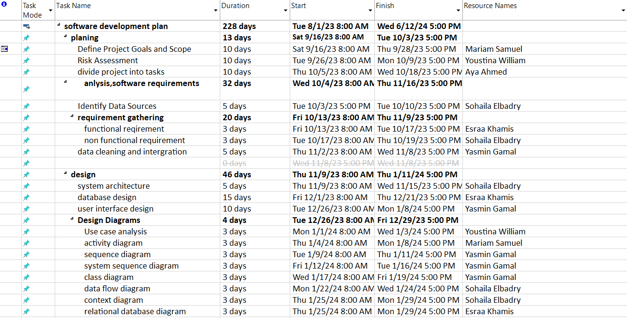

Slide 28
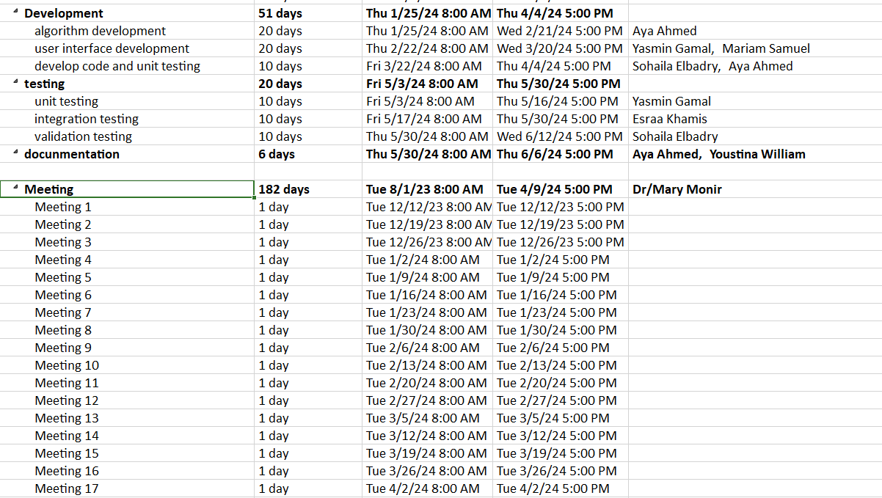

Slide 29
8
UI/UX design

Slide 30
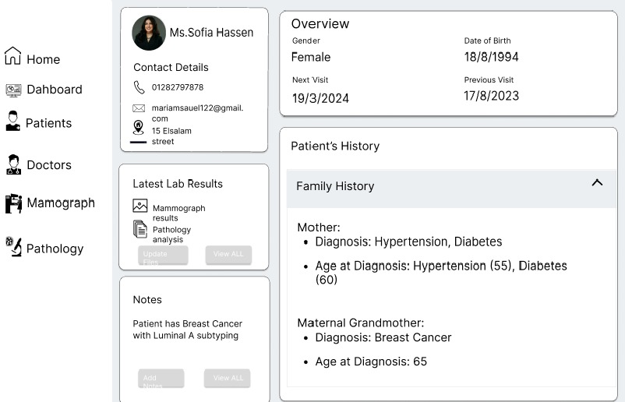
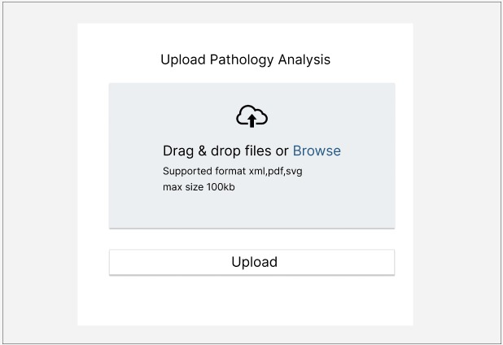
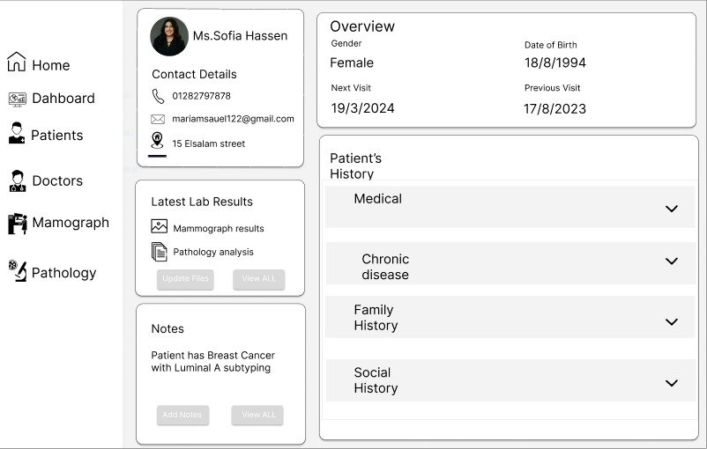

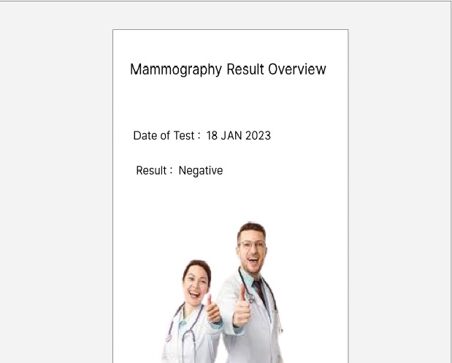

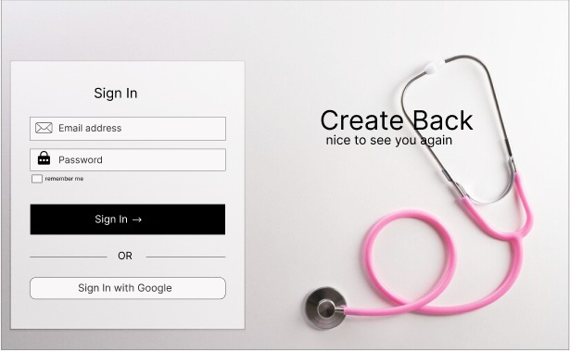
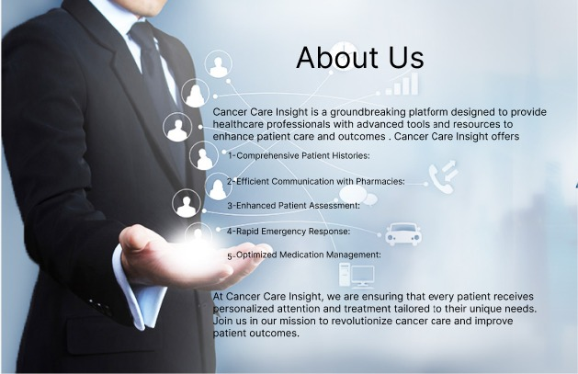
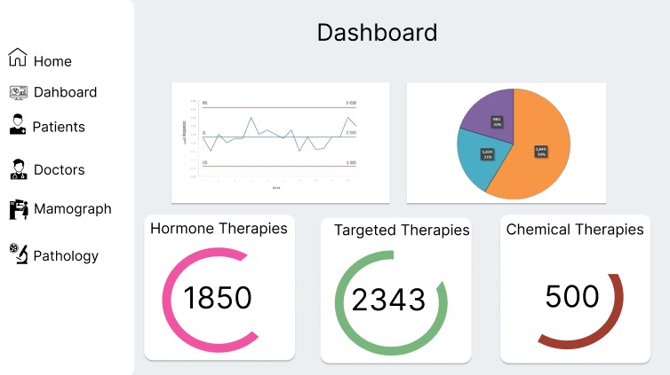
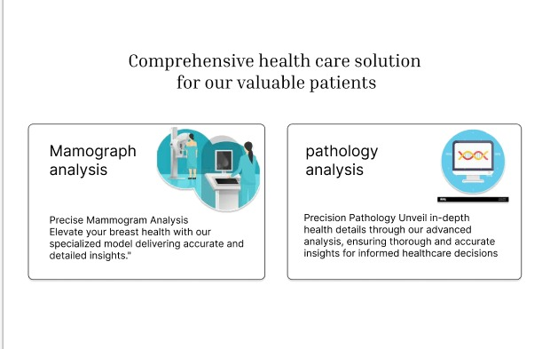
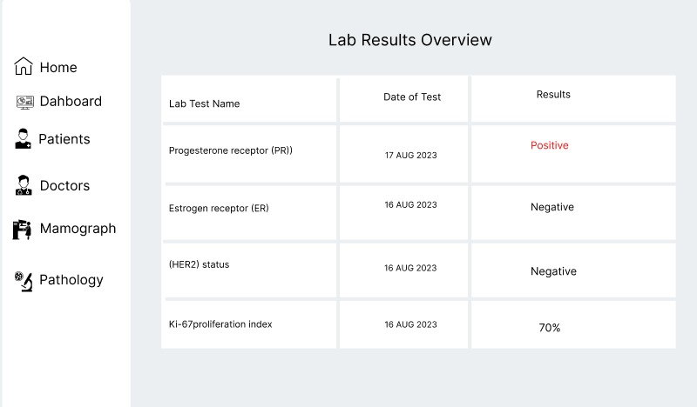

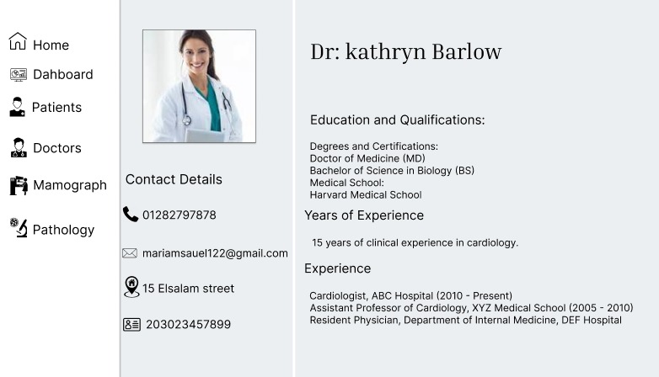
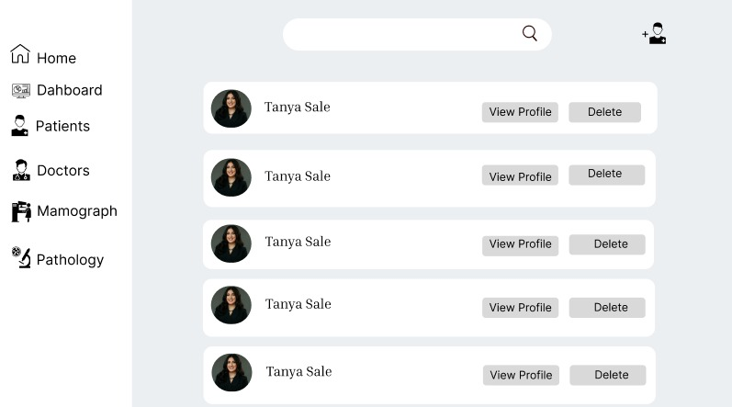
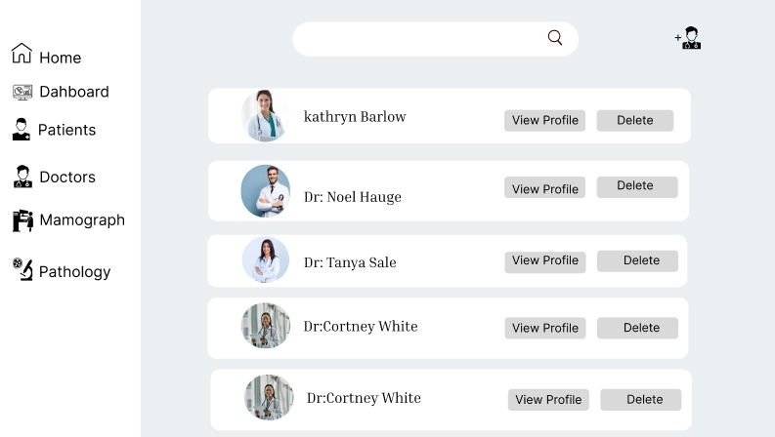
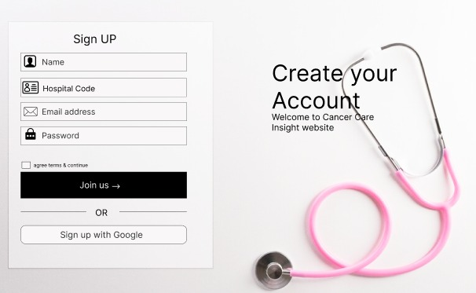

Slide 31
9- References
1- Hoteit, Hawraa, et al. "Breast Abnormalities' Classification Using Convolutional Neural Network." 2022 International Conference on Smart Systems and Power Management (IC2SPM). IEEE, 2022.
2- Das, Himanish Shekhar, et al. "Breast cancer detection: Shallow convolutional neural network against deep convolutional neural networks based approach." Frontiers in Genetics 13 (2023): 1097207.
3- Horr, Christina, and Steven A. Buechler. "Breast Cancer Consensus Subtypes: A system for subtyping breast cancer tumors based on gene expression." NPJ breast cancer 7.1 (2021): 136.
4- Gupta, Surbhi, et al. "Deep learning techniques for cancer classification using microarray gene expression data." Frontiers in Physiology 13 (2022): 952709.

Slide 32
Thank you for your attendance

